Slide 1
STUDENT_INFO-HUB
TEAM :
1) SOPHIYA
2) ROOF SAGAR
3) SWAMY
4)HARSHA VARDHAN

Slide 2
ABSTRACT
STUDENT_INFO-HUB is a student management system developed to maintain and organize student records efficiently. The project provides a secure login system with a maximum of three authentication attempts using predefined ID and password verification(Only admin can access). After successful login, the system displays a menu-driven interface that allows the user to perform various operations such as viewing student records, adding new student details, deleting existing records, and exiting the program.
The application uses file handling concepts to store and manage student data based on student year, branch, and section. Separate functions are created for each operation and are called using a switch-case structure for better modularity and readability. The view option enables searching student details through branch, section and year inputs also displays the required record, while the add option creates and stores student information in appropriate files. The delete option searches records using student ID and removes the selected data.
This project helps in simplifying student data management, reducing manual effort, improving accuracy, and providing organized access to student information through a user-friendly interface.

Slide 3
INTRO
The rapid growth of educational institutions has increased the need for efficient student record management systems. Maintaining student information manually is time-consuming, difficult to organize, and prone to errors. To overcome these problems, the STUDENT_INFO-HUB project is developed as a simple and effective student management system that helps in storing, accessing, updating, and managing student records digitally.(Some systems already exists)
The system is designed using programming concepts such as file handling, functions, conditional statements, loops, and switch-case operations. It provides a secure login mechanism where only authorized users can access the system with valid credentials. The login process also limits invalid attempts to ensure basic security.
After successful login, the user can perform different operations including viewing student records, adding new student details, deleting existing records, and exiting the application. Student information is stored in files according to year, branch, and section, which improves organization and simplifies data retrieval.
The main objective of this project is to reduce manual work, improve accuracy, save time, and provide a user-friendly way to manage student information efficiently. The project also demonstrates the practical implementation of file management and modular programming concepts in a real-world application.

Slide 4
ALGORITHM
STEP 01 : START
STEP 02 : SET attempts = 0
STEP 03 : Store original password, original ID
STEP 04 : READ Password, ID
STEP 05 : DECLARE choice, Search ID
STEP 06 : IF(password, ID is correct), Login successful
ELSE, only 3 attempts
STEP 07 : DISPLAY menu list
STEP 08 : SELECT a valid option
STEP 09 : CREATE individual functions and call through switch case
STEP 10 : IF(option is view), File with students list opens
STEP 11 : SEARCH by Year, Branch, Section and view
STEP 12 : IF(option is add),
STEP 13 : CREATE a file (based on student year, branch and section)
STEP 14 : IF(option is delete)
STEP 15 : SEARCH through ID, then delete
STEP 16 : EXIT(0) (last option)
STEP 17 : STOP

Slide 5
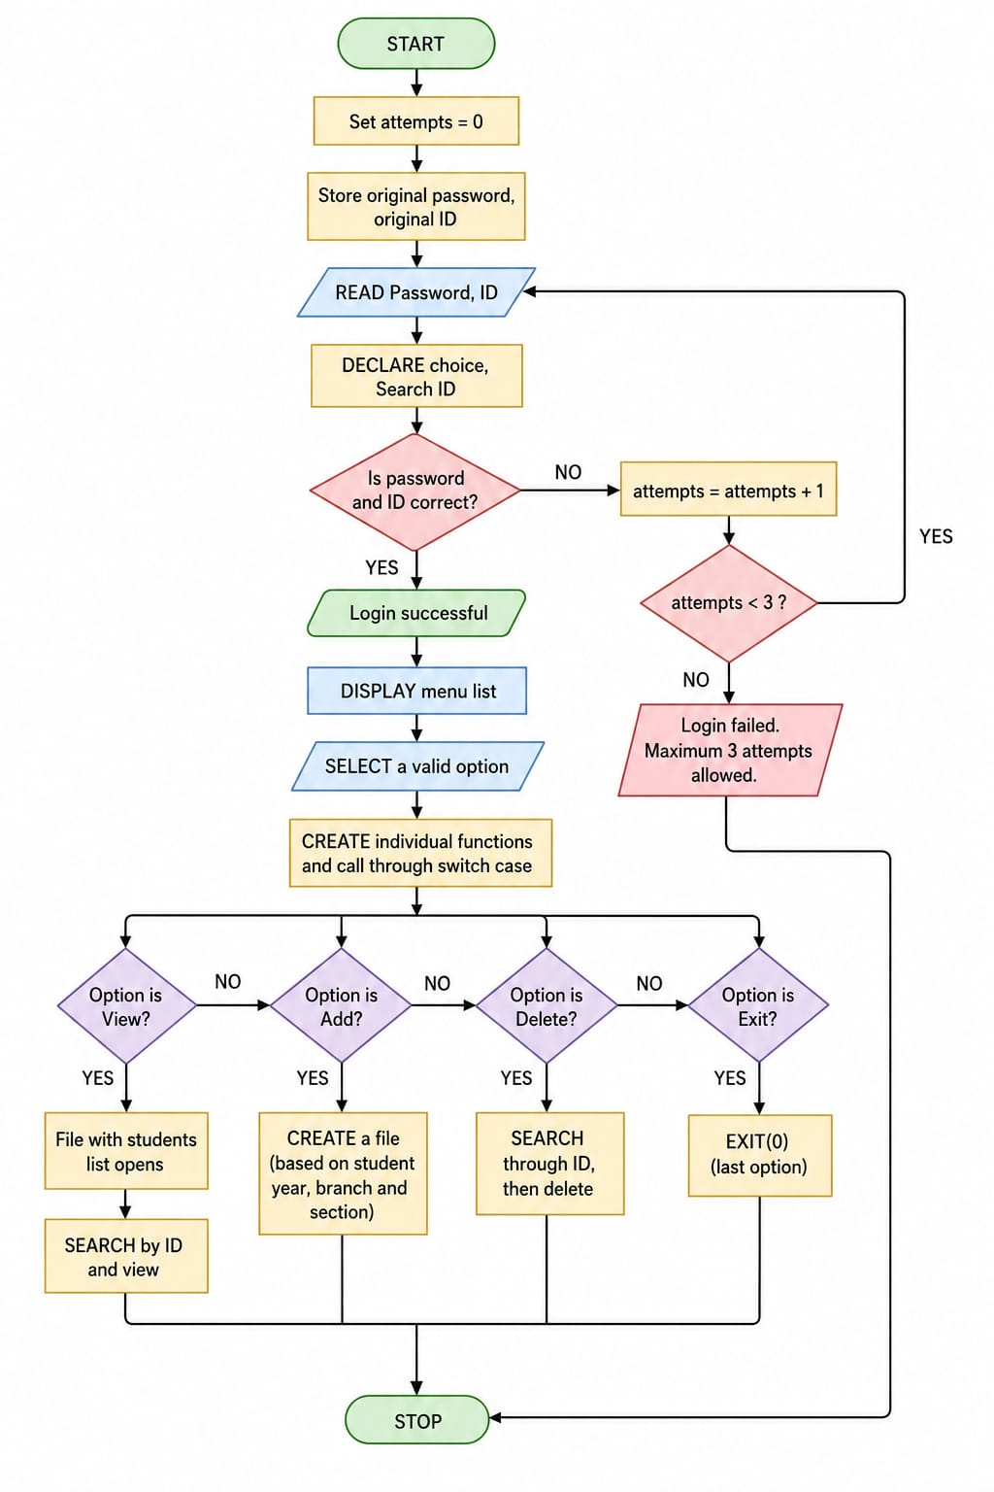
FLOW CHART

Slide 6
METHODOLOGY
The methodology of the STUDENT_INFO-HUB project is designed to manage student information systematically using file handling and menu-driven operations. The working process of the system is explained below:
The system starts by initializing the login attempt counter and storing the original ID and password.
The user is asked to enter the login credentials. The entered ID and password are verified with the stored credentials.
If the credentials are incorrect, the user is allowed a maximum of three attempts. If all attempts fail, the system terminates the login process.
After successful authentication, the main menu is displayed with different options such as View, Add, Delete, and Exit.
The selected option is processed using separate functions through a switch-case structure for better organization and modular programming.
In the View operation, the system opens the student records file, displays the students list through branch, section and year.
In the Add operation, a new file or record is created based on the student’s year, branch, and section, and the entered data is stored permanently.
In the Delete operation, the system searches the student record using Student ID and removes the corresponding data from the file.
The Exit option terminates the program safely using the exit function.
The entire system is implemented to ensure efficient student record management, easy data retrieval, reduced manual work, and secure access control.

Slide 7
RESULT SCREEN SHOTS

Slide 8
CONCLUSION
Here by, we want to conclude that STUDENT_INFO-HUB is a student management system which can store student details more accurately by using file handling.
Only admin can access this system and can make modifications with ID and Password login access. Hence the data is secure at admin so that no one other can open and see the student details without admin's ID and Password. Every major detail of student is included and this system can be an error free one. Even if admin make a mistake, still he/she can be asked to enter the detail again. In this way we want to conclude that this system is well accurate and well capable.

Slide 9
THANK YOU

